Slide 1
BTECH
A.Y. 2023-2024
Project Title: DocSense - Document Summarization with Enhanced Natural-Language Search Engine
Presented by :
Adarsh Agarwal - 70012000239
Saakar Chaudhary - 70012000195
Farhan Shaikh - 70012000292
Under the guidance of : Saurav Verma
1

Slide 2
What is DocSense?
DocSense is an AI-powered chatbot that trains on your data to provide contextual responses.
It can be used to turn your knowledge base into a customized LLM-chatbot.
DocSense is not your regular AI bot platform. This NLP-based AI chatbot with LLM powers can act as a single source of truth for all your customer interactions providing a dynamic user experience.

Slide 3

Where does ChatGPT fail?
(and DocSense succeeds)
ChatGPT’s knowledge is limited to its training data, which has the cutoff year of 2021 and it cannot access the internet or external links.

Slide 4
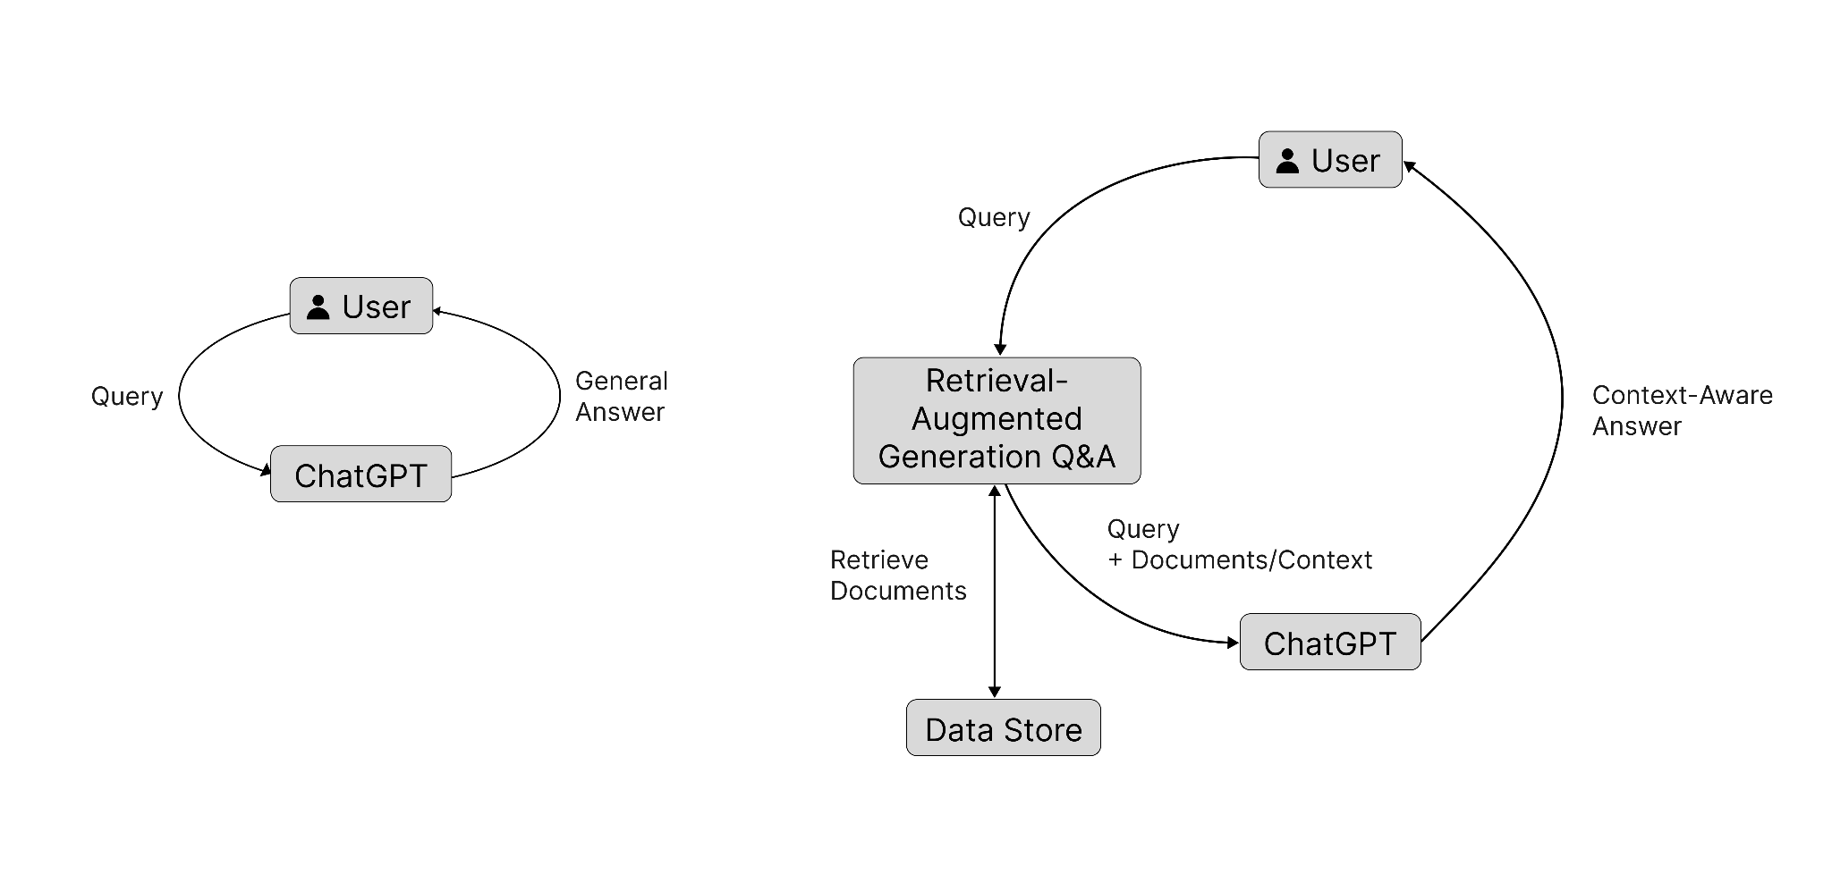

Slide 5
Project Objectives:
1. Develop and Deploy AI-Powered Custom Chatbots
2. Automate Customer Support and Improve Experience
3. Integration with Diverse Platforms and Environments
4. Advanced Semantic Search and Contextual Response Generation
5. Scalable and Efficient Infrastructure

Slide 6
Project Scope:
1.Natural Language Understanding (NLU):The chatbot will be designed to comprehend natural language inputs from users. It will be capable of understanding various queries and instructions, including questions, requests for information, and search commands.
2. Documentation Access: The primary function of the chatbot will be to access a diverse range of documents. These documents will be indexed and organised to enable efficient information retrieval.
3. Integration with Existing Systems: The chatbot will be designed to integrate seamlessly with existing documentation systems or knowledge bases to leverage the existing resources effectively.

Slide 7
Project Scope:
4. Search Assistance: Users can ask the chatbot for assistance in finding specific information or solutions to problems within the provided documents. The chatbot will perform advanced searches and return relevant excerpts to the relevant sections.
5. Contextual Responses: The chatbot will be able to maintain context throughout the conversation, ensuring more accurate responses to follow-up questions and queries.
6.Scalability and Performance: The chatbot's architecture should be scalable to handle a large number of concurrent users and deliver responses with minimal latency.

Slide 8
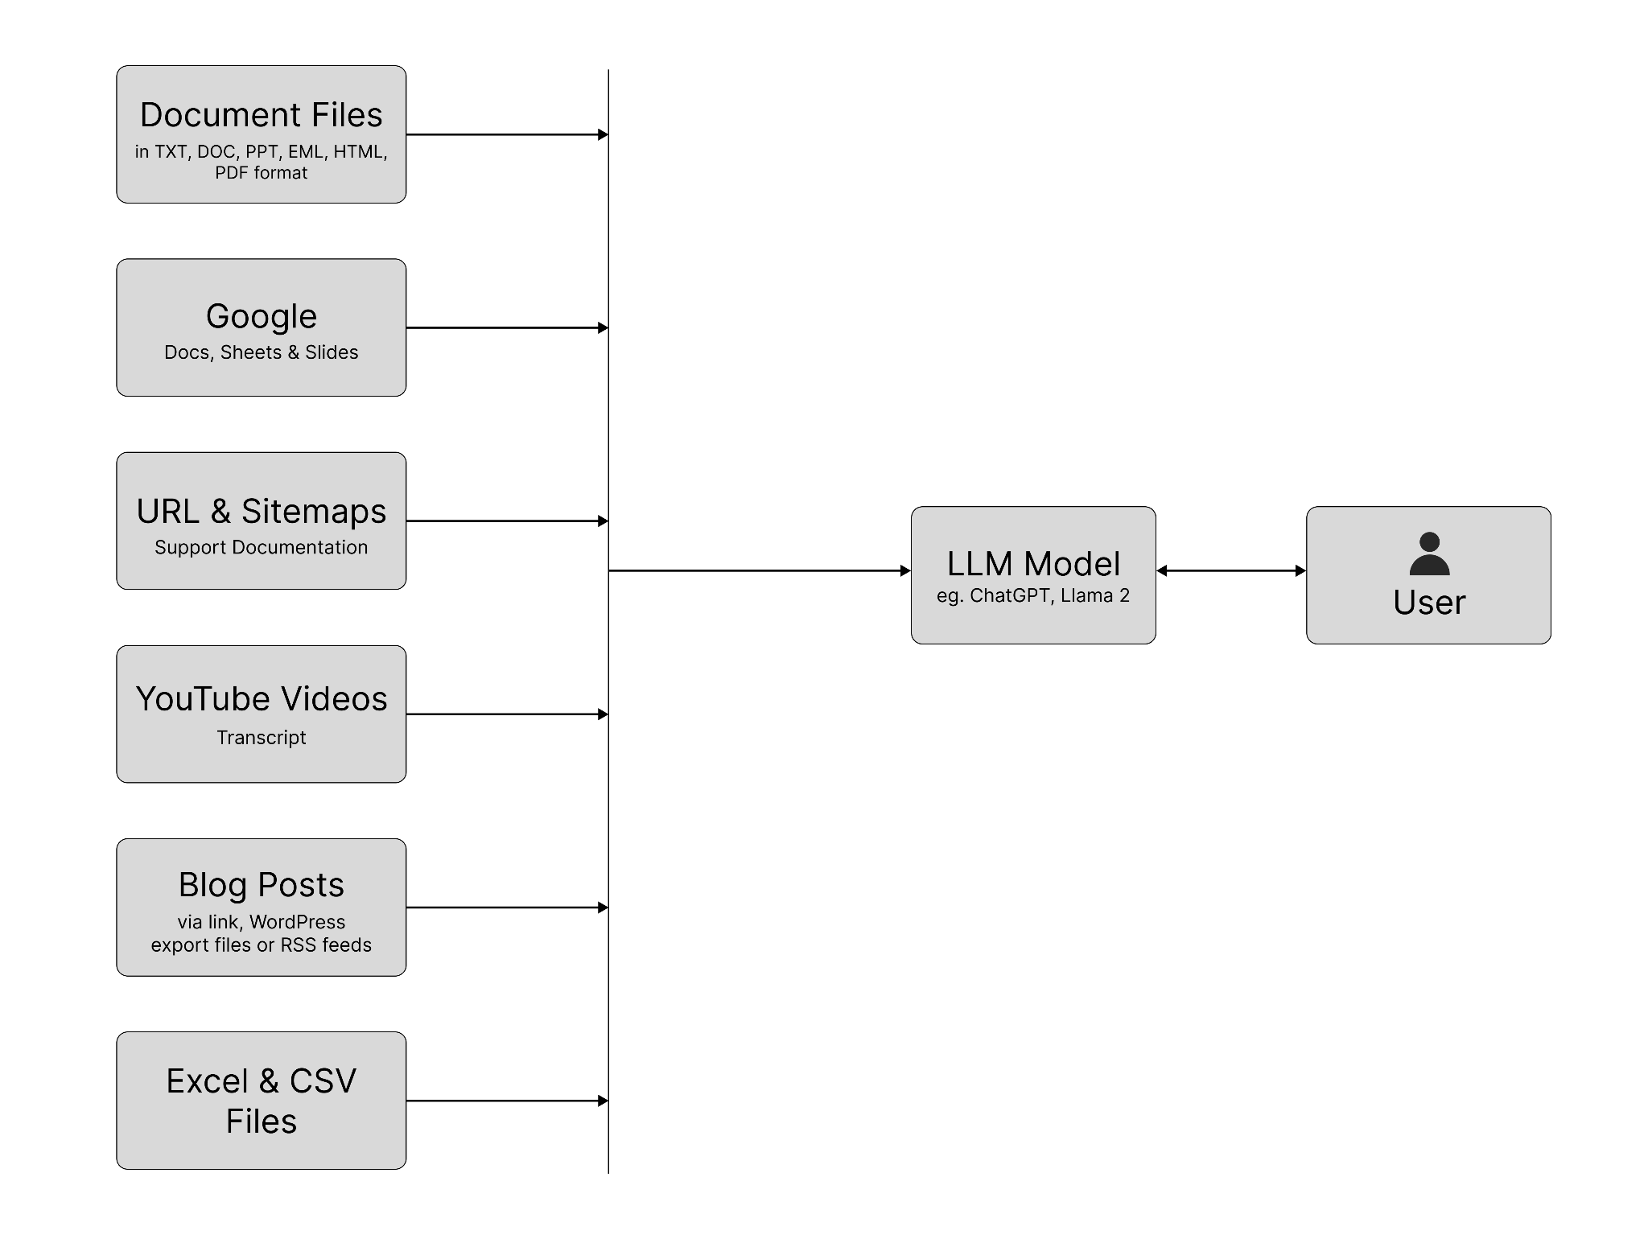

Slide 9
Hardware and software to be used:
API development and Backend: Python, Flask, Pinecone
Frontend: Webflow and Javascript
LLM Model: LLama 2
Deployment: Replicate

Slide 10
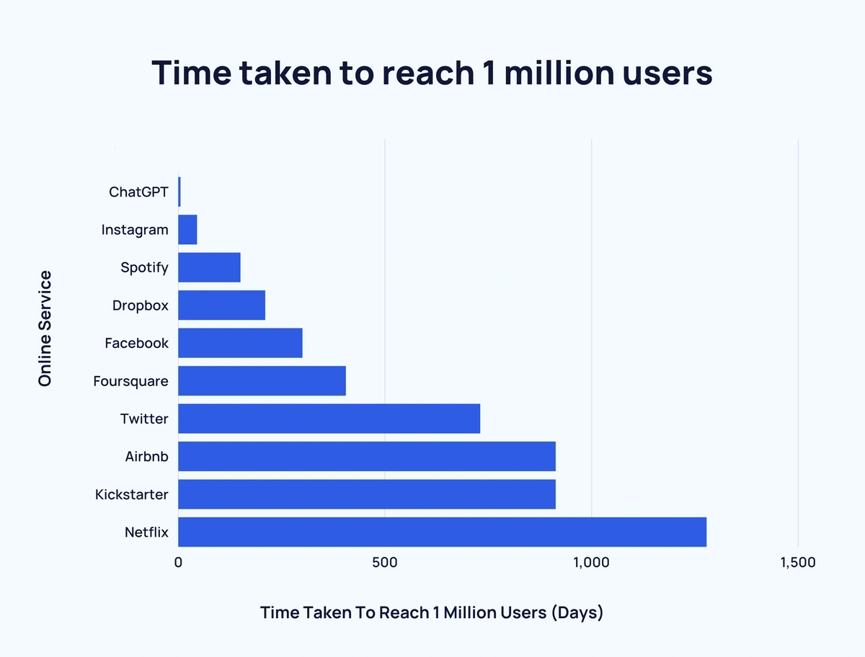
Motivation
Why Artificial Intelligence?
Chat GPT was the fastest software to achieve 1M user in the history of the internet.
Reacting to the public’s enthusiasm about AI and its various applications, we want to create a AI powered application.

Slide 11
Motivation
Why DOCSENSE?
Access to vast repositories of information is crucial for individuals and organizations alike
Sheer volume of documents, manuals, and other sources of knowledge can often overwhelm users, making it challenging to find and comprehend the information they seek efficiently.
Conventional search engines and static documentation systems may not always provide the interactive, intelligent, and user-friendly experience necessary to facilitate seamless information retrieval and understanding.

Slide 12
Expected Outcomes
Develop AI-powered chatbots integration
Improve customer support experience
Boost team productivity
Optimize AI copywriting
Implement advanced integrations and data analysis
Enable easy student research

